Slide 1
Recurrent Neural Networks. Long Short-Term Memory. Sequence-to-sequence.
Radu Ionescu, Prof. PhD.
raducu.ionescu@gmail.com
Faculty of Mathematics and Computer Science
University of Bucharest

Slide 2
Plan for Today
Model
Recurrent Neural Networks (RNNs)
Learning
BackProp Through Time (BPTT)
Vanishing / Exploding Gradients
LSTMs
Sequene-to-sequence

Slide 3

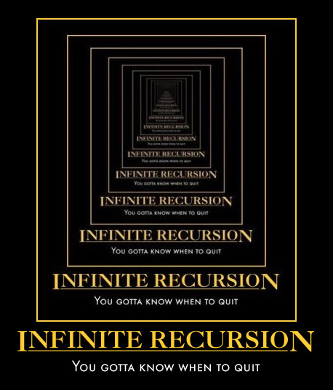
New Topic: RNNs
Image Credit: Andrej Karpathy

Slide 4
Synonyms
Recurrent Neural Networks (RNNs)
Recursive Neural Networks
General family; think graphs instead of chains
Types:
Long Short Term Memory (LSTMs)
Gated Recurrent Units (GRUs)
…
Algorithms
BackProp Through Time (BPTT)
BackProp Through Structure (BPTS)

Slide 5
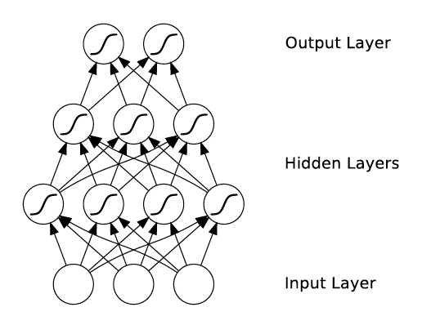
What’s wrong with MLPs?
Problem 1: Can’t model sequences
Fixed-sized Inputs & Outputs
No temporal structure
Problem 2: Pure feed-forward processing
No “memory”, no feedback
Image Credit: Alex Graves, book

Slide 6
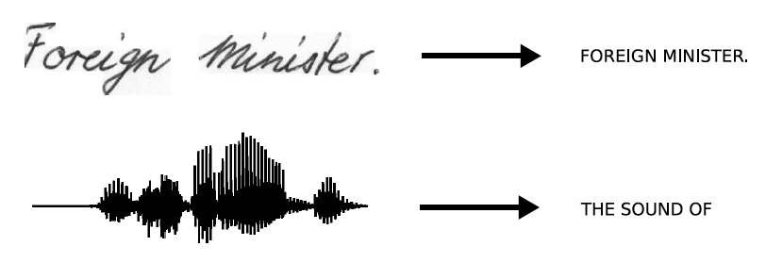
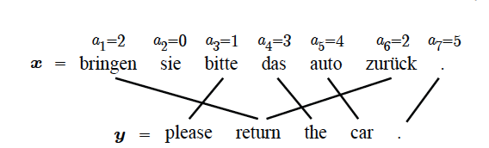
Sequences are everywhere…
Image Credit: Alex Graves and Kevin Gimpel

Slide 7
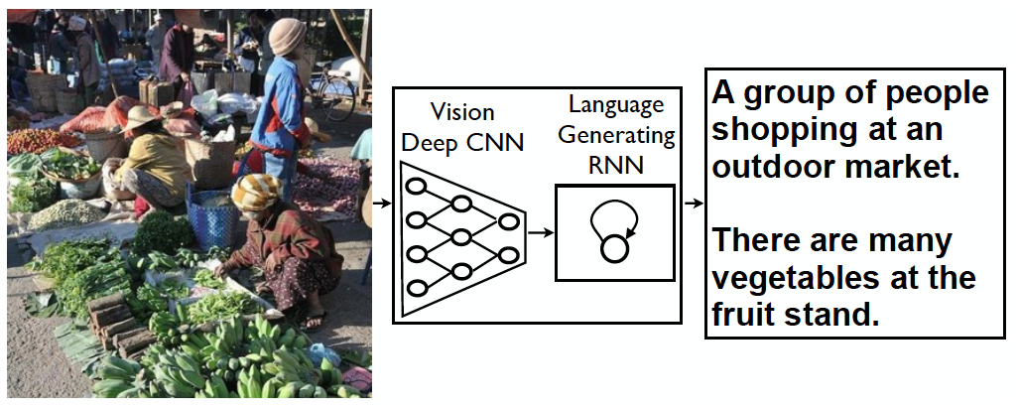
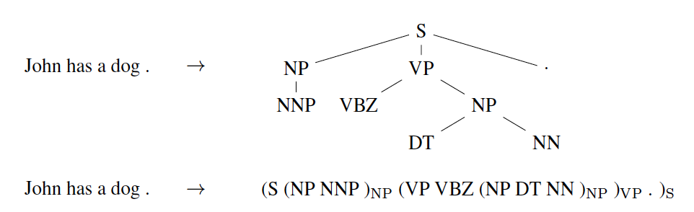
Even where you might not expect a sequence…
Image Credit: Vinyals et al.

Slide 8


Even where you might not expect a sequence…
Input ordering = sequence
Image Credit: Ba et al.; Gregor et al
https://arxiv.org/pdf/1502.04623.pdf

Slide 9
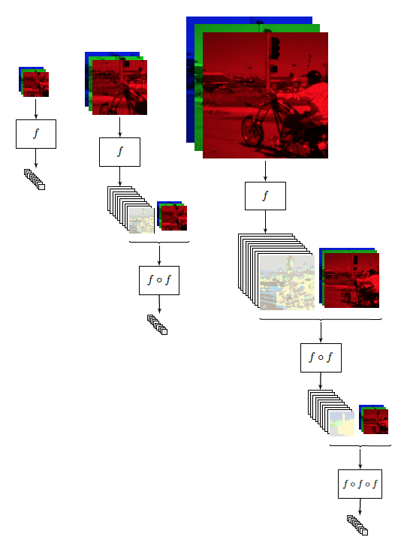
Image Credit: [Pinheiro and Collobert, ICML14]

Slide 10
Why model sequences?
Figure Credit: Carlos Guestrin

Slide 11
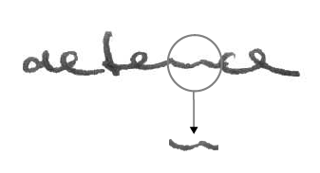
Why model sequences?
Image Credit: Alex Graves

Slide 12
The classic approach
Y₁ = {a,…z}
Y₂ = {a,…z}
Y₃ = {a,…z}
Y₄ = {a,…z}
Y₅ = {a,…z}
X₁ =
X₂ =
X₃ =
X₄ =
X₅ =
Hidden Markov Model (HMM)
Figure Credit: Carlos Guestrin

Slide 13
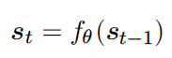
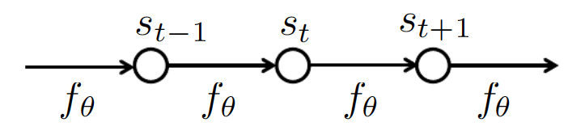
How do we model sequences?
No input
Image Credit: Bengio, Goodfellow, Courville

Slide 14
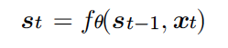
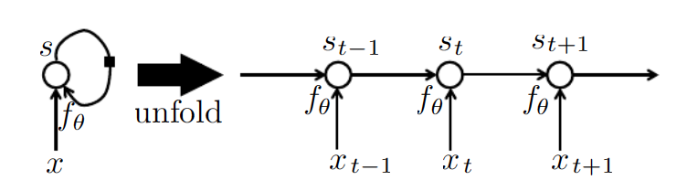
How do we model sequences?
With inputs
Image Credit: Bengio, Goodfellow, Courville

Slide 15
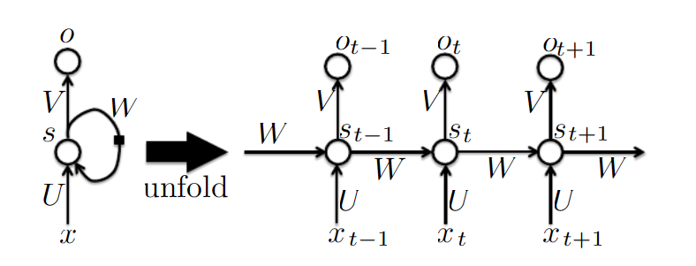
How do we model sequences?
With inputs and outputs
Image Credit: Bengio, Goodfellow, Courville

Slide 16
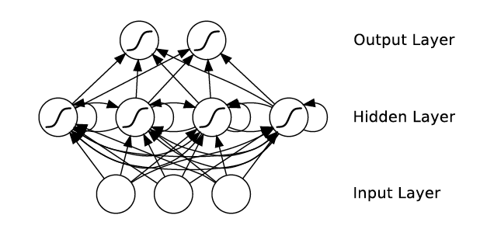
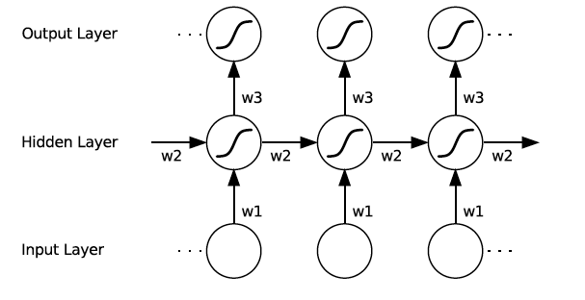
How do we model sequences?
With Neural Nets
Image Credit: Alex Graves

Slide 17
How do we model sequences?
It’s a spectrum…
Input: No sequence
Output: No sequence
Example: “standard” classification / regression problems
Input: No sequence
Output: Sequence
Example: Im2Caption
Input: Sequence
Output: No sequence
Example: sentence classification, multiple-choice question answering
Input: Sequence
Output: Sequence
Example: machine translation, video captioning, video question answering
Image Credit: Andrej Karpathy

Slide 18
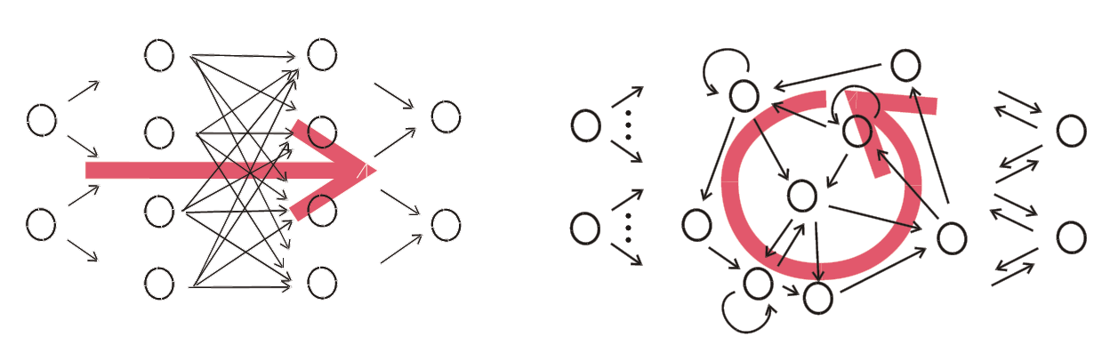
Things can get arbitrarily complex
Image Credit: Herbert Jaeger

Slide 19
Key Ideas
Parameter Sharing + Unrolling
Keeps numbers of parameters in check
Allows arbitrary sequence lengths!
“Depth”
Measured in the usual sense of layers
Not unrolled timesteps
Learning
Is tricky even for “shallow” models due to unrolling

Slide 20
Plan for Today
Model
Recurrent Neural Networks (RNNs)
Learning
BackProp Through Time (BPTT)
Vanishing / Exploding Gradients
LSTMs
Sequene-to-sequence

Slide 21
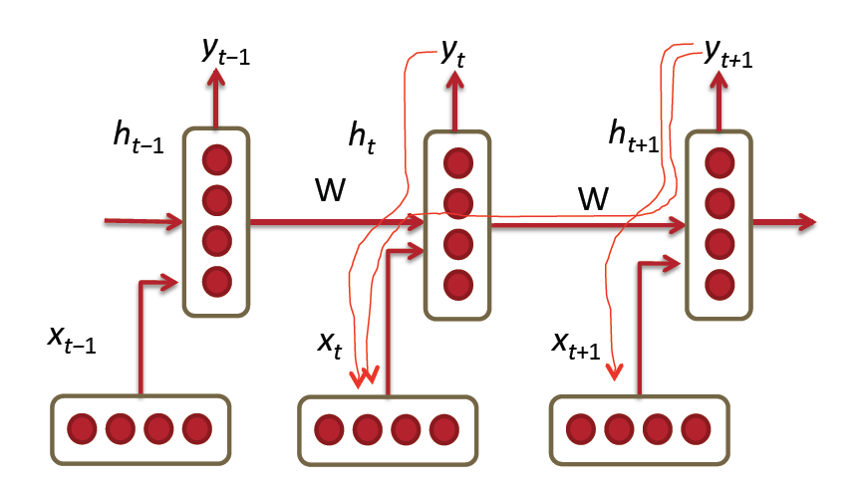
BPTT
Image Credit: Richard Socher

Slide 22
BPTT
Algorithm:
Present a sequence of timesteps of input and output pairs to the network.
Unroll the network then calculate and accumulate errors across each timestep.
Roll-up the network and update weights.
Repeat.
In Truncated BPTT, the sequence is processed one timestep at a time and periodically (k₁ timesteps) the BPTT update is performed back for a fixed number of timesteps (k₂ timesteps).

Slide 23
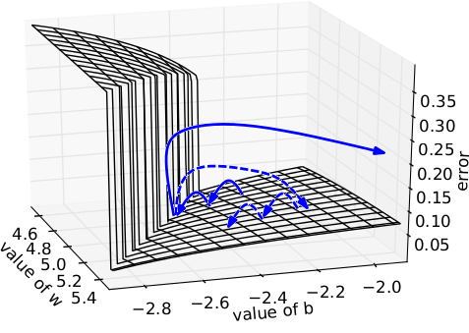
Illustration [Pașcanu et al]
Intuition
Error surface of a single hidden unit RNN; High curvature walls
Solid lines: standard gradient descent trajectories
Dashed lines: gradient rescaled to fix problem

Slide 24
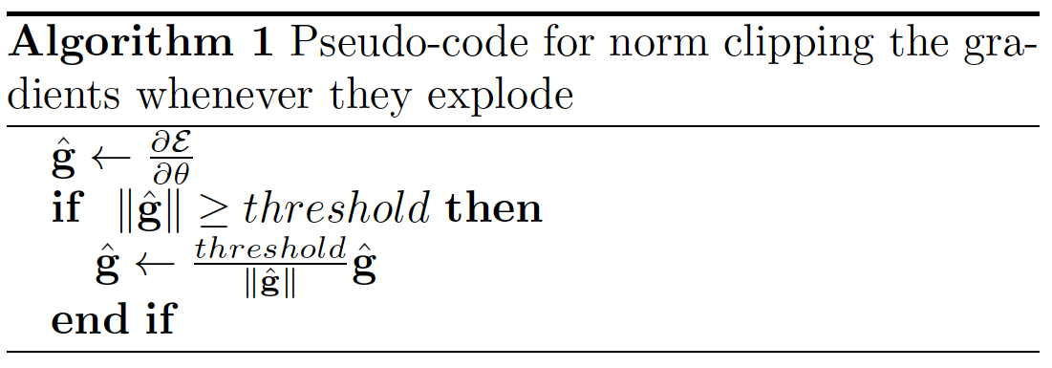
Fix #1
Norm Clipping (pseudo-code)
Image Credit: Richard Socher

Slide 25
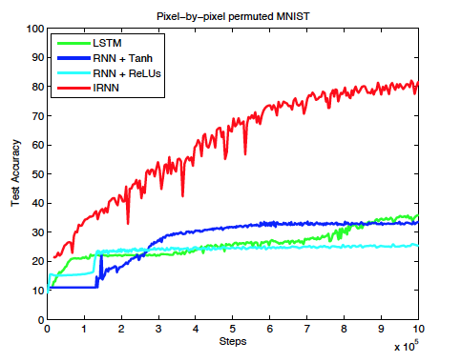
Fix #2
Smart Initialization and ReLUs
[Socher et al 2013]
A Simple Way to Initialize Recurrent Networks of Rectified Linear Units [Le et al. 2015]
“We initialize the recurrent weight matrix to be the identity matrix and biases to be zero. This means that each new hidden state vector is obtained by simply copying the previous hidden vector then adding on the effect of the current inputs and replacing all negative states by zero.”

Slide 26
Long Short-Term Memory

Slide 27


RNN
Basic block diagram
Image Credit: Christopher Olah (http://colah.github.io/posts/2015-08-Understanding-LSTMs/)

Slide 28
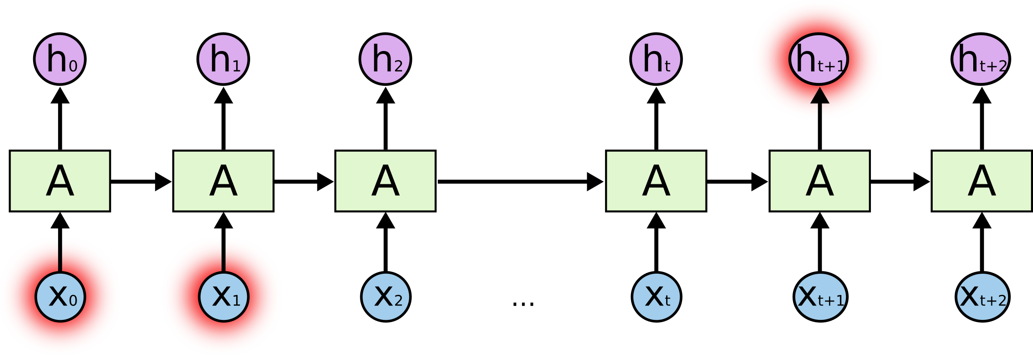
Key Problem
Learning long-term dependencies is hard
Image Credit: Christopher Olah (http://colah.github.io/posts/2015-08-Understanding-LSTMs/)

Slide 29

Meet LSTMs
How about we explicitly encode memory?
Image Credit: Christopher Olah (http://colah.github.io/posts/2015-08-Understanding-LSTMs/)

Slide 30

LSTMs Intuition: Memory
Cell State / Memory
Image Credit: Christopher Olah (http://colah.github.io/posts/2015-08-Understanding-LSTMs/)

Slide 31
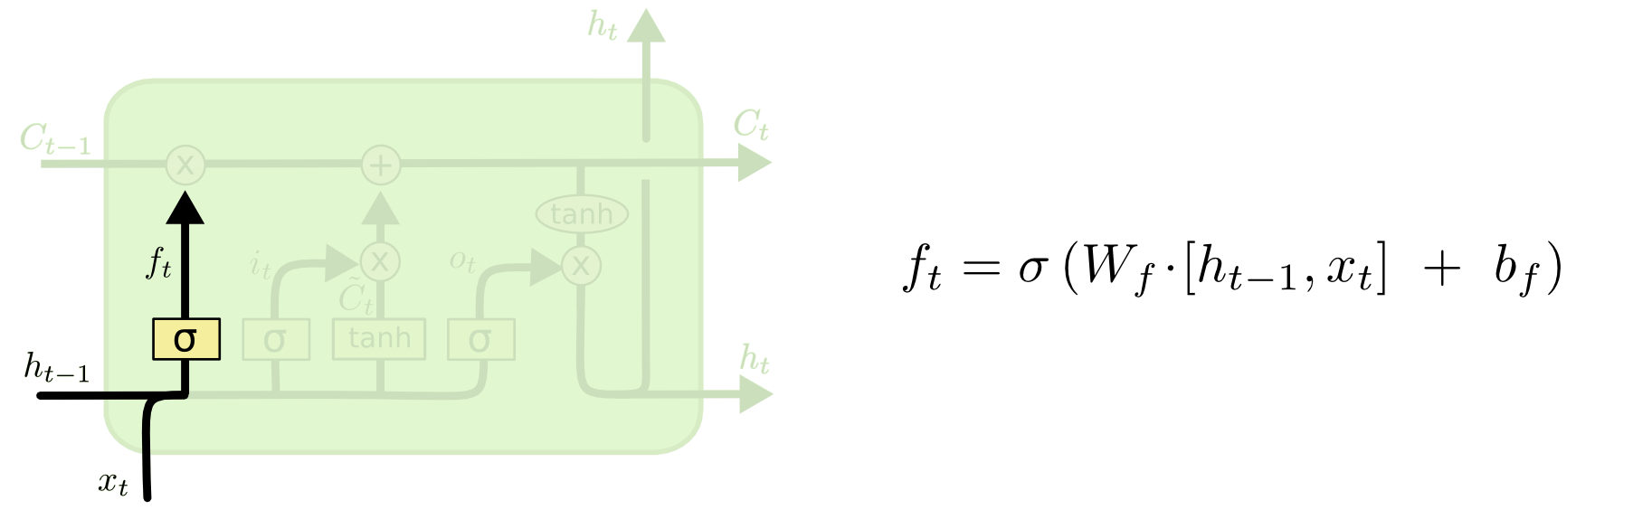
LSTMs Intuition: Forget Gate
Should we continue to remember this “bit” of information or not?
Image Credit: Christopher Olah (http://colah.github.io/posts/2015-08-Understanding-LSTMs/)

Slide 32
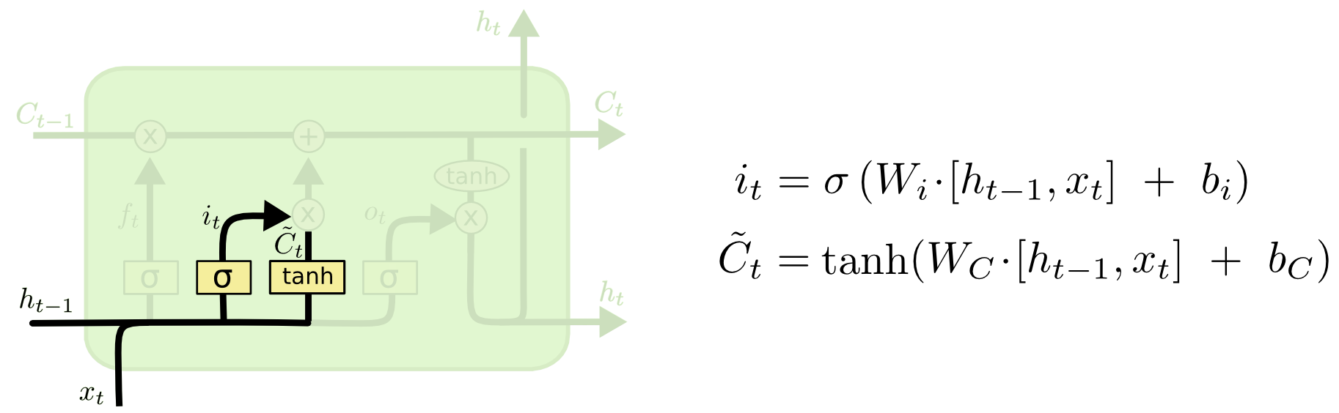
LSTMs Intuition: Input Gate
Should we update this “bit” of information or not?
If so, with what?
Image Credit: Christopher Olah (http://colah.github.io/posts/2015-08-Understanding-LSTMs/)

Slide 33
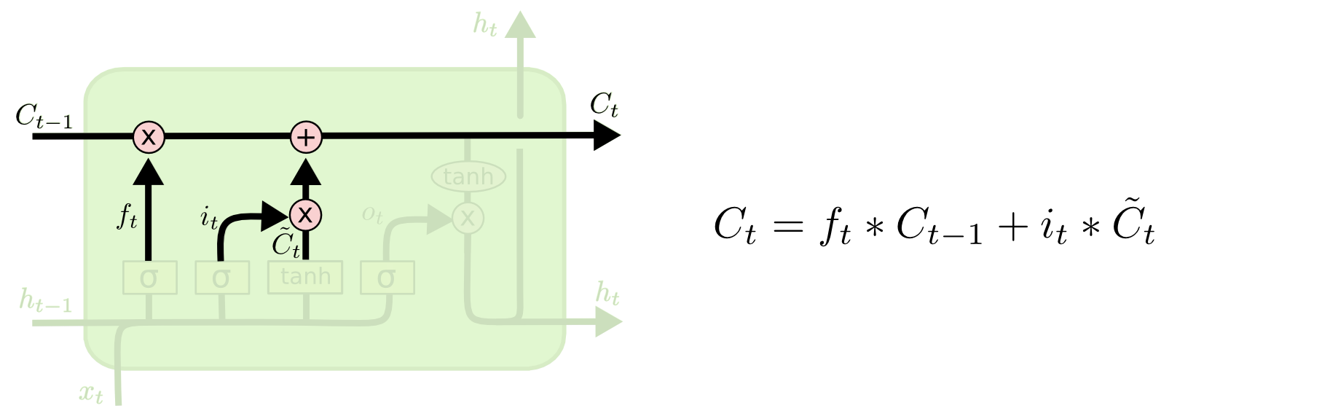
LSTMs Intuition: Memory Update
Forget that + memorize this
Image Credit: Christopher Olah (http://colah.github.io/posts/2015-08-Understanding-LSTMs/)

Slide 34
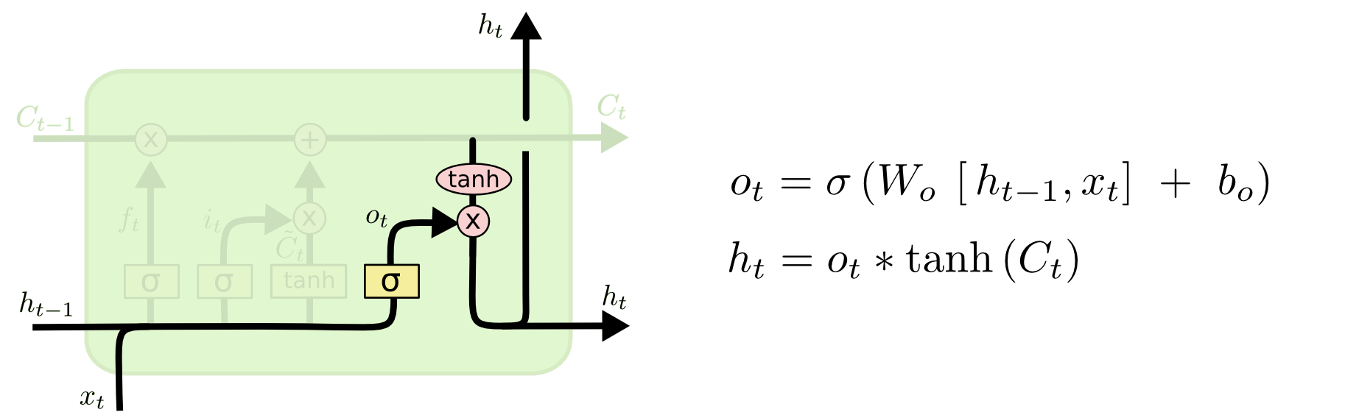
LSTMs Intuition: Output Gate
Should we output this “bit” of information to “deeper” layers?
Image Credit: Christopher Olah (http://colah.github.io/posts/2015-08-Understanding-LSTMs/)

Slide 35
LSTMs
A pretty sophisticated cell
Image Credit: Christopher Olah (http://colah.github.io/posts/2015-08-Understanding-LSTMs/)

Slide 36
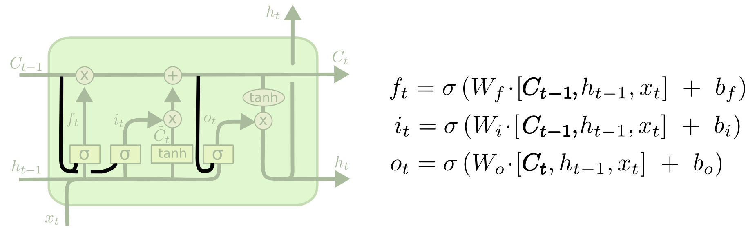
LSTM Variants #1: Peephole Connections
Let gates see the cell state / memory
Image Credit: Christopher Olah (http://colah.github.io/posts/2015-08-Understanding-LSTMs/)

Slide 37
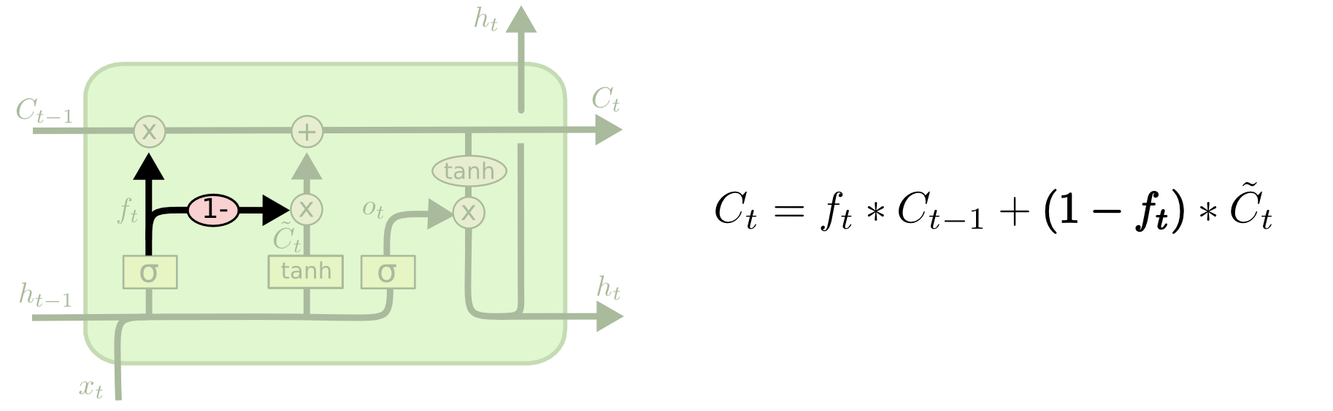
LSTM Variants #2: Coupled Gates
Only memorize new if forgetting old
Image Credit: Christopher Olah (http://colah.github.io/posts/2015-08-Understanding-LSTMs/)

Slide 38
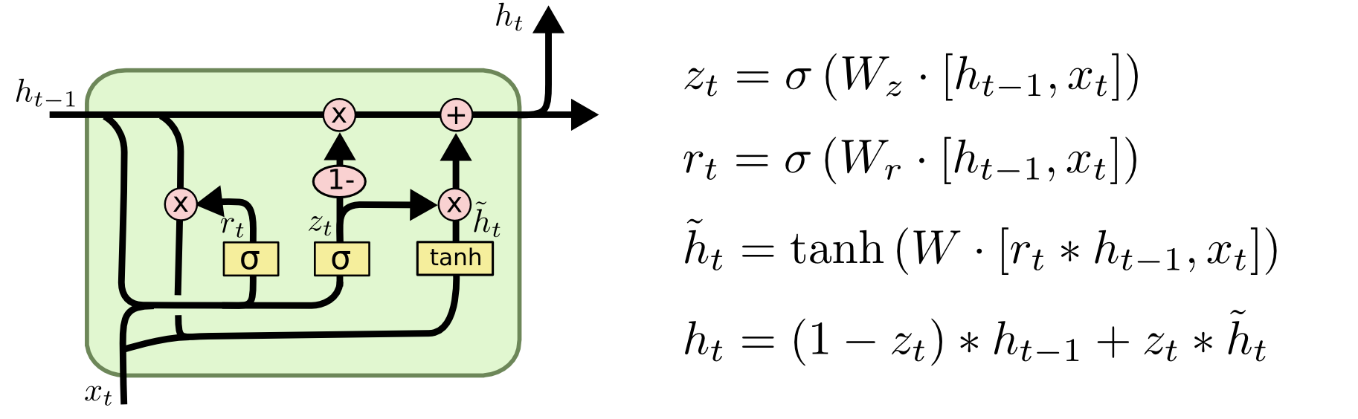
LSTM Variants #3: Gated Recurrent Units
Changes:
No explicit memory; memory = hidden output
Z = memorize new and forget old
Image Credit: Christopher Olah (http://colah.github.io/posts/2015-08-Understanding-LSTMs/)

Slide 39
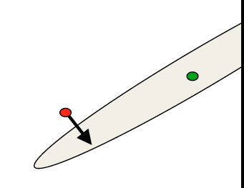
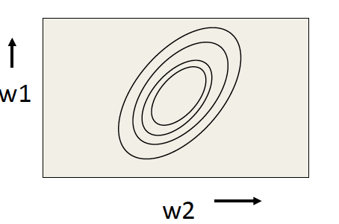
RMSProp Intuition
Gradients ≠ Direction to Opt
Gradients point in the direction of steepest ascent locally
Not where we want to go long term
Mismatch gradient magnitudes
magnitude large = we should travel a small distance
magnitude small = we should travel a large distance
Image Credit: Geoffrey Hinton

Slide 40
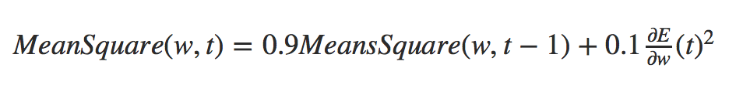
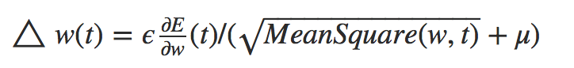
RMSProp Intuition
Keep track of previous gradients to get an idea of magnitudes over batch
Divide by this accumulate

Slide 41
Sequence to Sequence Learning

Slide 42
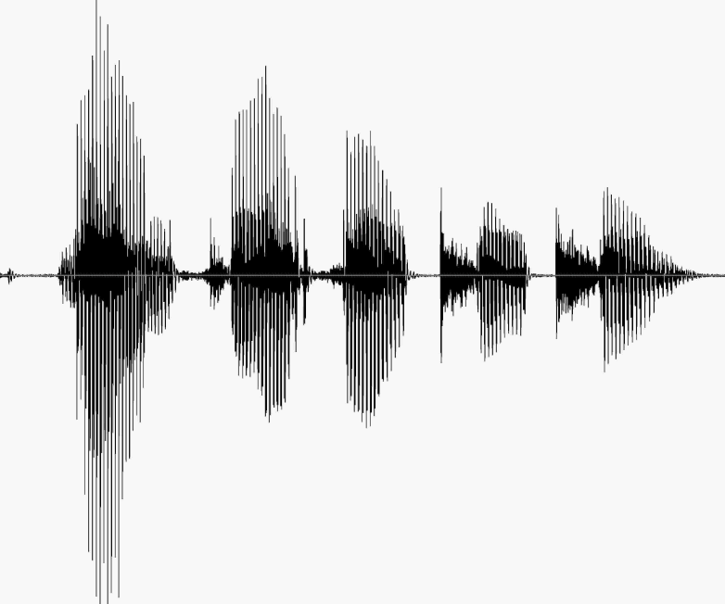
Sequence to Sequence
Speech recognition
http://nlp.stanford.edu/courses/lsa352/

Slide 43

Sequence to Sequence
Machine translation
Bine ați venit la cursul de învățare profundă
Welcome to the deep learning class

Slide 44

Sequence to Sequence
Question answering

Slide 45
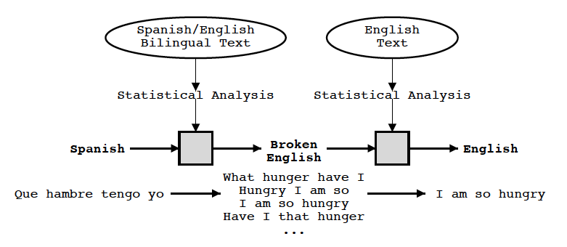
Statistical Machine Translation
Knight and Koehn 2003

Slide 46
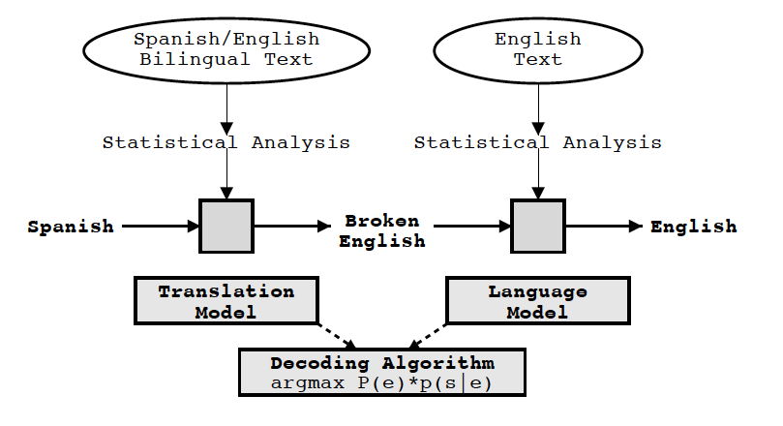
Statistical Machine Translation
Knight and Koehn 2003

Slide 47
Statistical Machine Translation
Components:
Translation Model
Language Model
Decoding

Slide 48
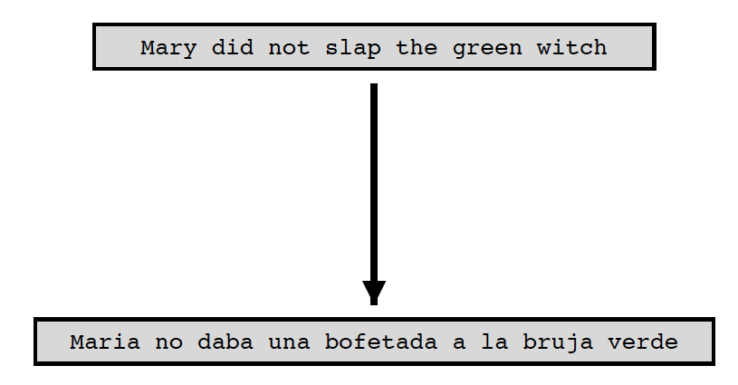
Statistical Machine Translation
Translation model
Learn the P(f | e)
Knight and Koehn 2003

Slide 49
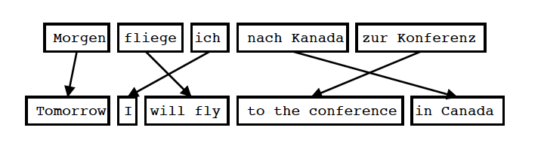
Statistical Machine Translation
Translation model
Input is segmented into phrases
Each phrase is translated into English
Phrases are reordered
Koehn 2004

Slide 50
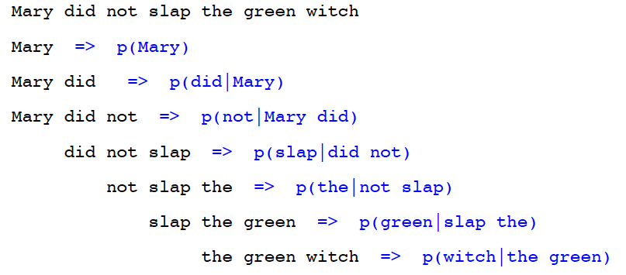
Statistical Machine Translation
Language Model
Goal of the Language Model: Detect good English P(e)
Standard Technique: Trigram Model
Knight and Koehn 2003

Slide 51
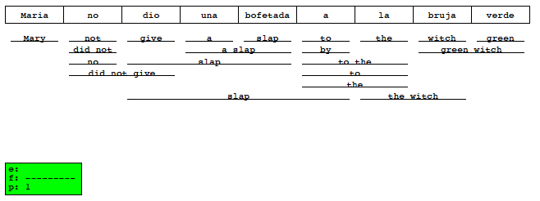
Statistical Machine Translation
Decoding
Goal of the decoding algorithm: Put models to work, perform the actual translation
Koehn 2004

Slide 52
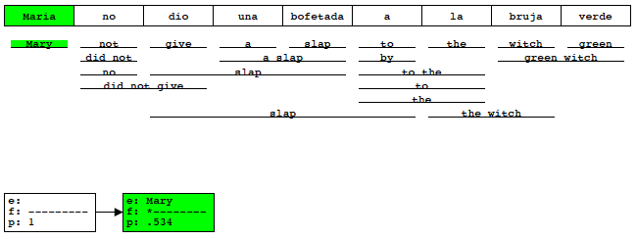
Statistical Machine Translation
Decoding
Goal of the decoding algorithm: Put models to work, perform the actual translation
Koehn 2004

Slide 53
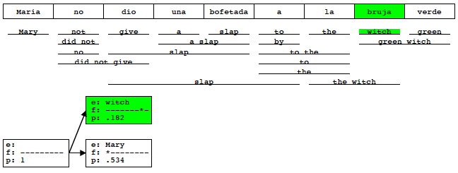
Statistical Machine Translation
Decoding
Goal of the decoding algorithm: Put models to work, perform the actual translation
Koehn 2004

Slide 54
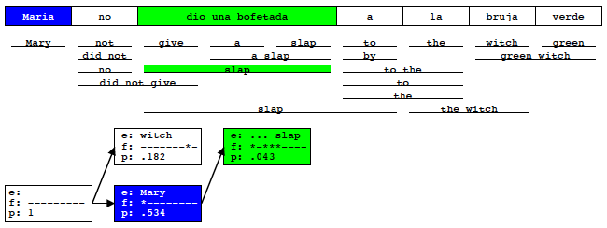
Statistical Machine Translation
Decoding
Goal of the decoding algorithm: Put models to work, perform the actual translation
Koehn 2004

Slide 55
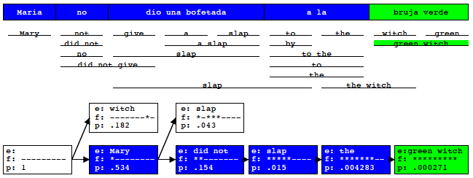
Statistical Machine Translation
Decoding
Goal of the decoding algorithm: Put models to work, perform the actual translation
Koehn 2004

Slide 56
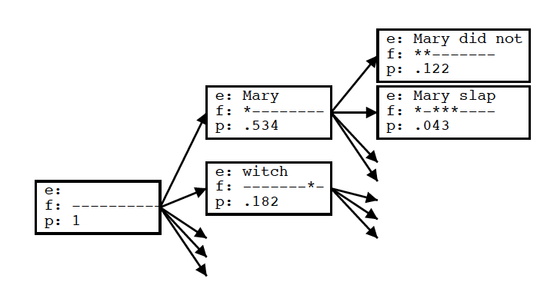
Statistical Machine Translation
Decoding
Goal of the decoding algorithm: Put models to work, perform the actual translation
Koehn 2004

Slide 57
Statistical Machine Translation
Decoding
Goal of the decoding algorithm: Put models to work, perform the actual translation
Prune out Weakest Hypotheses
by absolute threshold (keep 100 best)
by relative cutoff
Future Cost Estimation
compute expected cost of untranslated words

Slide 58
Sutskever et al., 2014
Sequence to Sequence Learning with Neural Networks

Slide 59
Neural Machine Translation
W X Y Z
Model
A B C

Slide 60
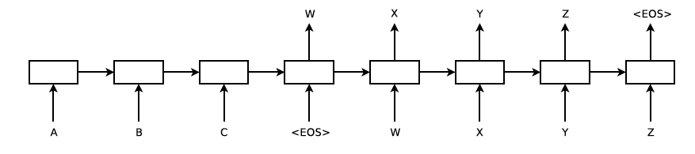
Neural Machine Translation
Model
Sutskever et al. 2014

Slide 61
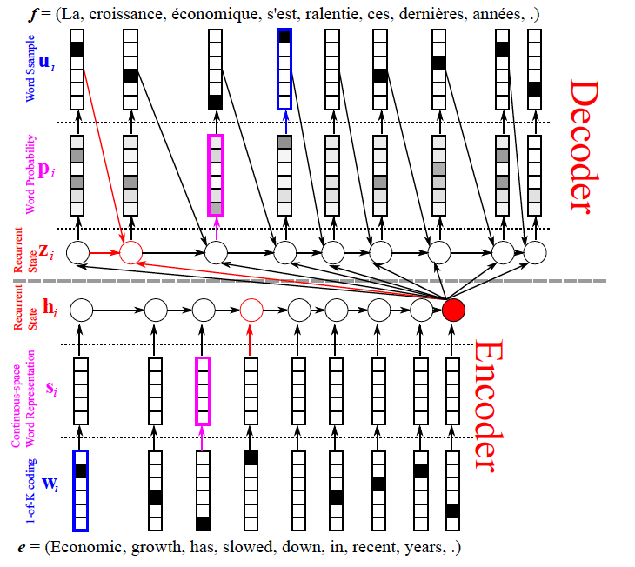
Neural Machine Translation
Model- encoder

Slide 62
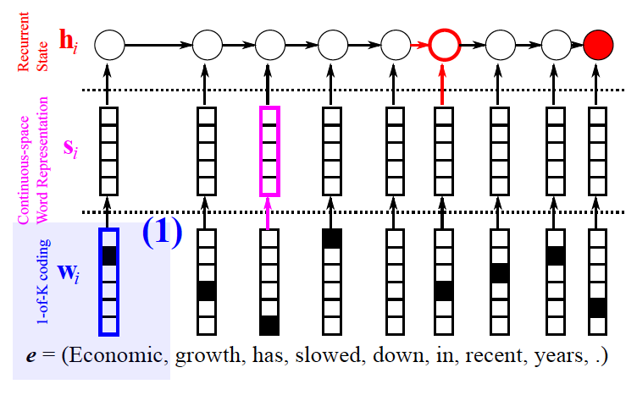
Neural Machine Translation
Model- encoder
Cho: From Sequence Modeling to Translation

Slide 63
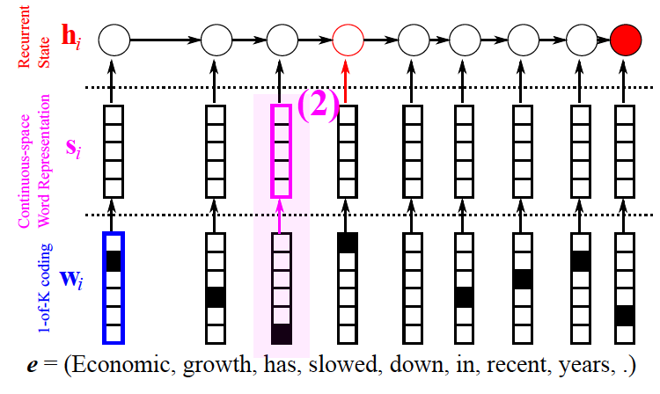
Neural Machine Translation
Model- encoder
Cho: From Sequence Modeling to Translation

Slide 64
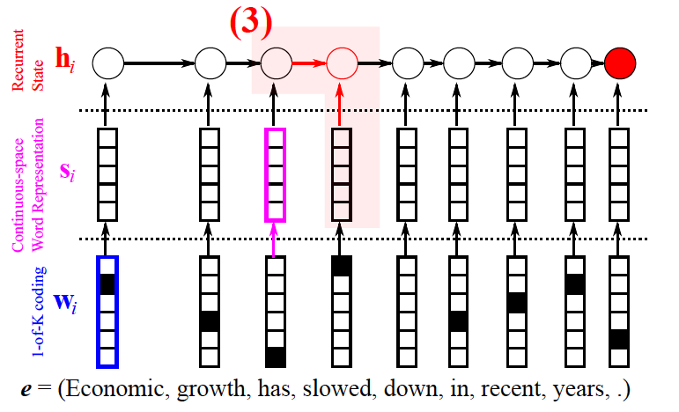
Neural Machine Translation
Model- encoder
Cho: From Sequence Modeling to Translation

Slide 65
Neural Machine Translation
Model- encoder
Cho: From Sequence Modeling to Translation

Slide 66
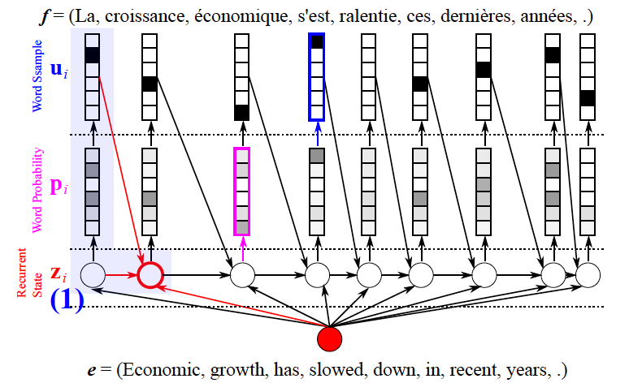
Neural Machine Translation
Model- decoder
Cho: From Sequence Modeling to Translation

Slide 67

Neural Machine Translation
Model- decoder
Cho: From Sequence Modeling to Translation

Slide 68

Neural Machine Translation
Model- decoder
Cho: From Sequence Modeling to Translation

Slide 69

Neural Machine Translation
RNN

Slide 70

Neural Machine Translation
RNN
Vanishing gradient
Cho: From Sequence Modeling to Translation

Slide 71

Neural Machine Translation
LSTM
Graves 2013

Slide 72
Neural Machine Translation
LSTM
Problem: Exploding gradient

Slide 73
Neural Machine Translation
LSTM
Problem: Exploding gradient
Solution: Scaling gradient

Slide 74
Sequence to Sequence
Reversing the Source Sentences
Welcome to the deep learning class

Slide 75
Sequence to Sequence
Reversing the Source Sentences
Welcome to the deep learning class

Slide 76
Sequence to Sequence
Results
BLEU score (Bilingual Evaluation Understudy)
https://en.wikipedia.org/wiki/BLEU
Candidate the the the the the the the
Reference 1 the cat is on the mat
Reference 2 there is a cat on the mat
m is number of words from the candidate that are found in the reference
w is the total number of words in the candidate
P = m / w = 7 / 7 = 1
Papineni et al. 2002

Slide 77
Sequence to Sequence
Results
BLEU score (Bilingual Evaluation Understudy)
https://en.wikipedia.org/wiki/BLEU
Candidate the the the the the the the
Reference 1 the cat is on the mat
Reference 2 there is a cat on the mat
P = 2 / 7
For each word in the candidate translation, the algorithm takes its maximum total count in any of the reference translations
Papineni et al. 2002

Slide 78

Sequence to Sequence
Results
Sutskever et al. 2014

Slide 79

Sequence to Sequence
Results
Sutskever et al. 2014

Slide 80

Sequence to Sequence
Model Analysis
Sutskever et al. 2014

Slide 81

Sequence to Sequence
Long sentences
Sutskever et al. 2014

Slide 82

Sequence to Sequence
Long sentences
Cho et al. 2014

Slide 83
Bahdanau et al.,2014
Neural Machine Translation by Jointly Learning to Align and Translate

Slide 84
Sequence to Sequence
Long sentences
Fixed length representation maybe the cause

Slide 85


Jointly Learning to Align and Translate
Attention mechanism

Slide 86
Jointly Learning to Align and Translate
Attention mechanism

Slide 87
Jointly Learning to Align and Translate
Attention mechanism

Slide 88
Jointly Learning to Align and Translate
Attention mechanism

Slide 89

Jointly Learning to Align and Translate
Attention mechanism

Slide 90

Jointly Learning to Align and Translate
Attention mechanism

Slide 91
Jointly Learning to Align and Translate
Attention mechanism

Slide 92

Jointly Learning to Align and Translate
Long sentences
Cho et al. 2014

Slide 93
Vinyals et al., 2015
Grammar as a Foreign Language

Slide 94

Grammar as a Foreign Language
Parsing tree

Slide 95
Grammar as a Foreign Language
Parsing tree

Slide 96
Grammar as a Foreign Language
Parsing tree

Slide 97
Grammar as a Foreign Language
Parsing tree

Slide 98
Grammar as a Foreign Language
Parsing tree
John has a dog .

Slide 99

Grammar as a Foreign Language
Converting tree to sequence

Slide 100
Grammar as a Foreign Language
Converting tree to sequence

Slide 101

Grammar as a Foreign Language
Model

Slide 102

Grammar as a Foreign Language
Results

